Slide 1
School of Computing Science and Engineering
PROJECT NAME:
Telegram Bot integrated with University
Submitted By:-
Sweta Kumari (21SCSE1011689)

Slide 2
School of Computing Science and Engineering
INTRODUCTION
This project focuses on developing a Telegram bot that integrates with various university systems, including iCloud, EMS (Educational Management System), LMS (Learning Management System), the library, and student groups. The goal is to provide a unified platform for students and faculty to access essential services and information conveniently through Telegram.
Importance of Integration in Educational Institutions
Educational institutions often use multiple platforms for managing academic and administrative tasks. However, the lack of integration among these systems can lead to inefficiencies and a fragmented user experience. By integrating these services into a single interface via a Telegram bot, the project aims to streamline access, improve communication, and enhance overall user satisfaction
Program Name: B.Tech

Slide 3
Objectives of the Telegram Bot
Centralized Access: To provide a single point of access to various university resources, making it easier for students and faculty to find and use information.
Enhanced Communication: To facilitate seamless communication within student groups and between students and faculty, helping to coordinate activities and share information quickly.
Automated Assistance: To offer automated responses to common queries, reducing the workload on administrative staff and providing instant help to users.
User-Friendly Experience: To create an intuitive and accessible interface, ensuring that users of all technical levels can easily interact with the bot and access the information they need.

Slide 4
Features of the Telegram Bot
S.No. | Commands | Their Responses
1. | Start | Give Greetings
2. | Help | Give list of commands
3. | Icloud | Give link of icloud EMS
4. | lms | Give link of GU LMS
5. | GU_elibrary | Give link of GU elibrary
6. | GU_Students_Travelling | Give link of GU students group

Slide 5
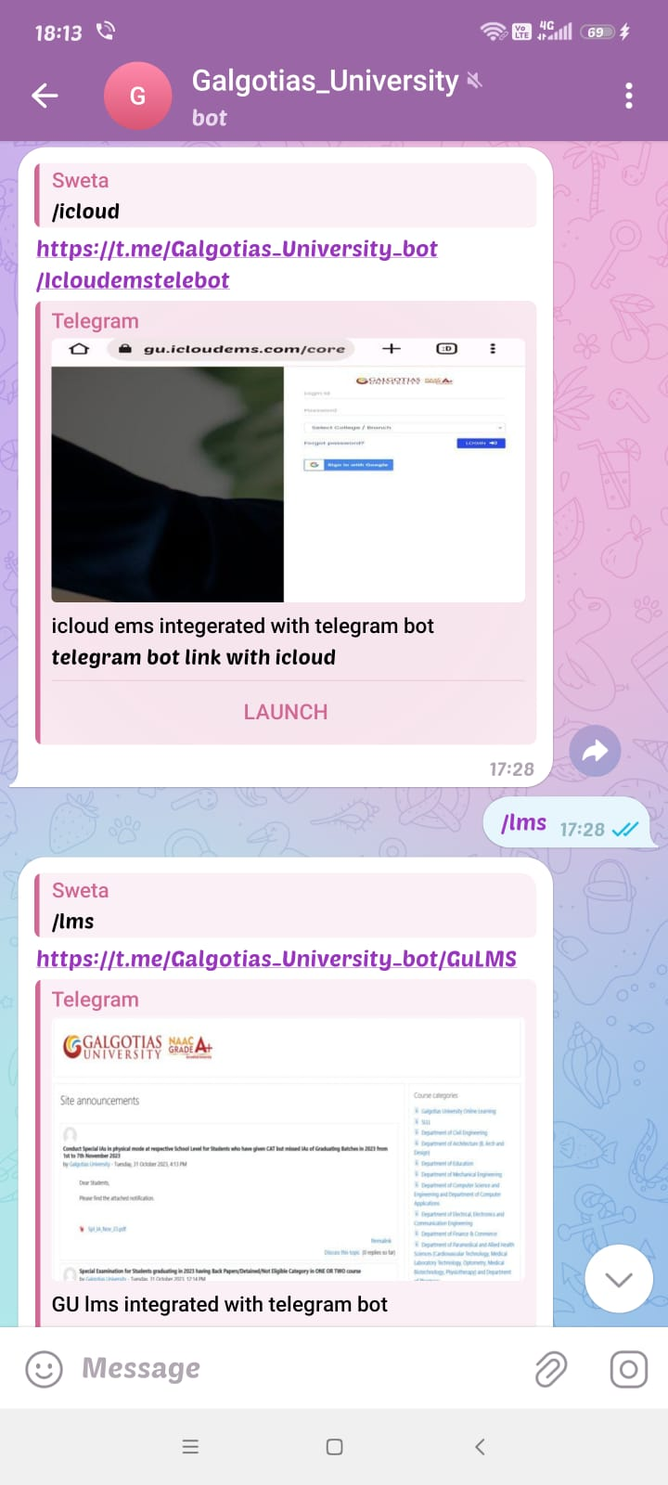
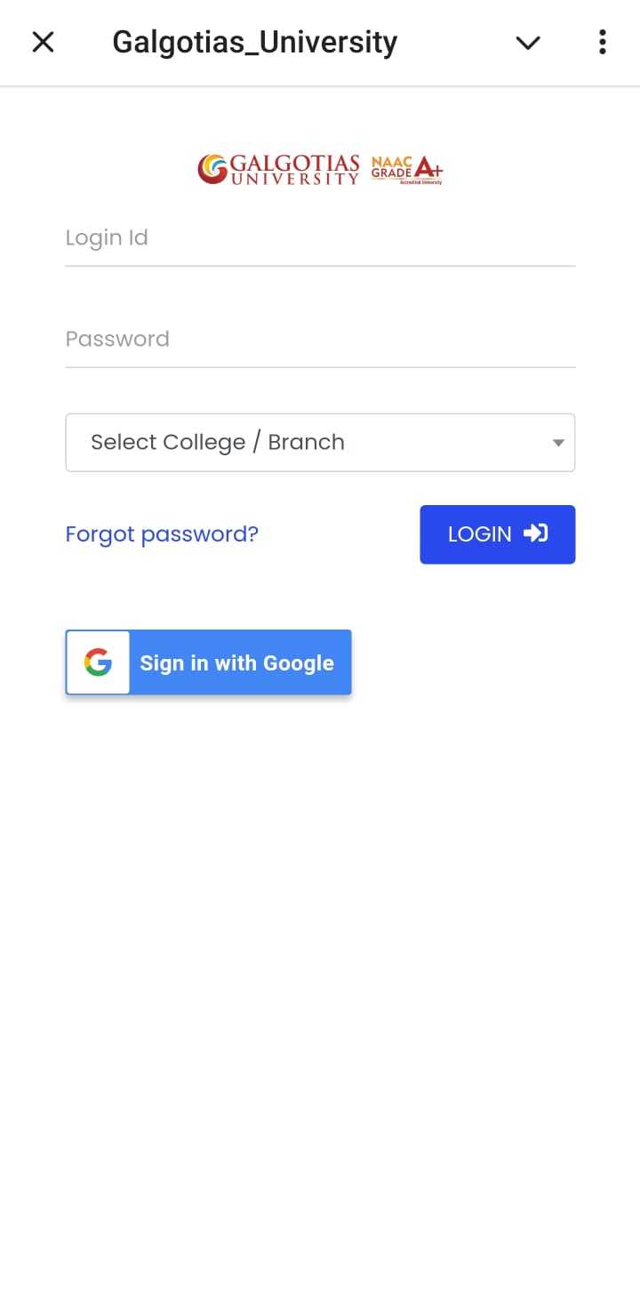
School of Computing Science and Engineering
Integration with iCloud
File Access: Students and faculty can easily access their iCloud files directly through the bot, including documents, presentations, and notes.
Backup and Sync: Automatic synchronization of important academic materials, ensuring that users have the latest versions available at all times.
Collaboration: Supports file sharing and collaborative workspaces, allowing students and faculty to collaborate on projects and assignments effortlessly.
Program Name: B.Tech

Slide 6
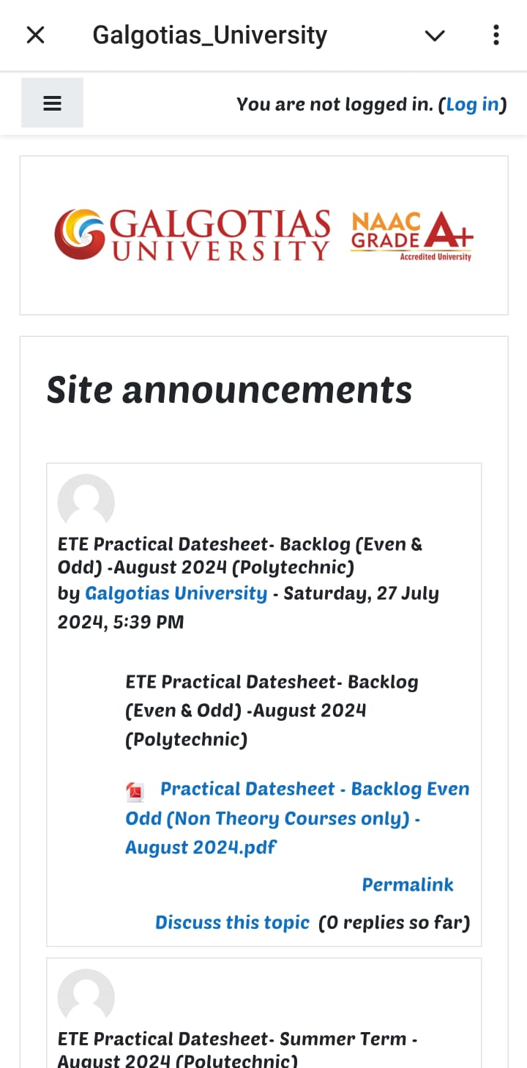
School of Computing Science and Engineering
LMS Integration
Class Schedules: Users can check their class schedules, including room numbers and instructor details, directly through the bot.
Grades and Assessments: Access to grades, feedback, and assessment results, enabling students to track their academic progress in real-time.
Course Materials: Quick access to course materials, including lecture slides, assignments, and reading lists, all in one place.
Program Name: B.Tech

Slide 7
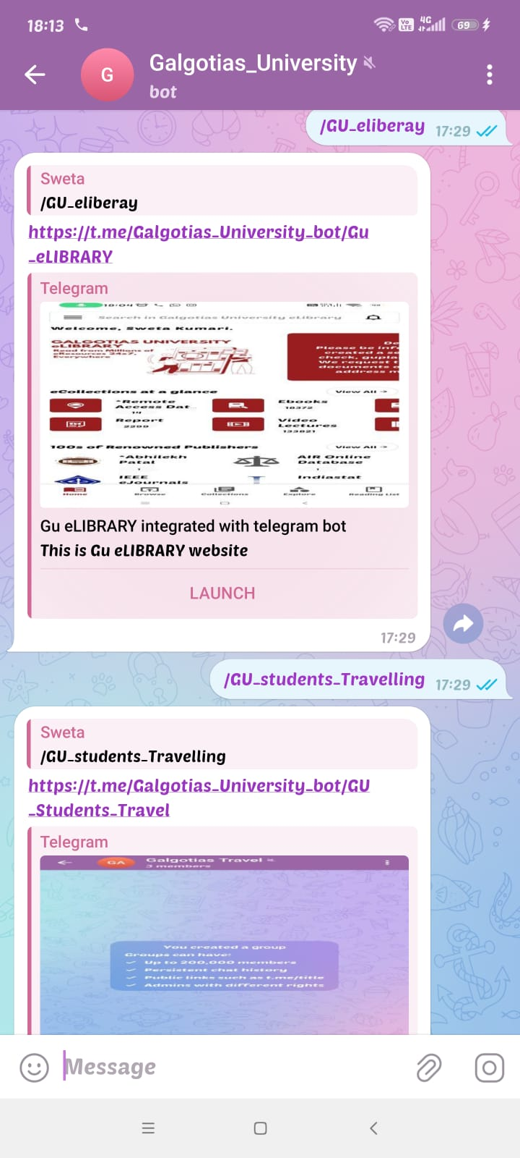
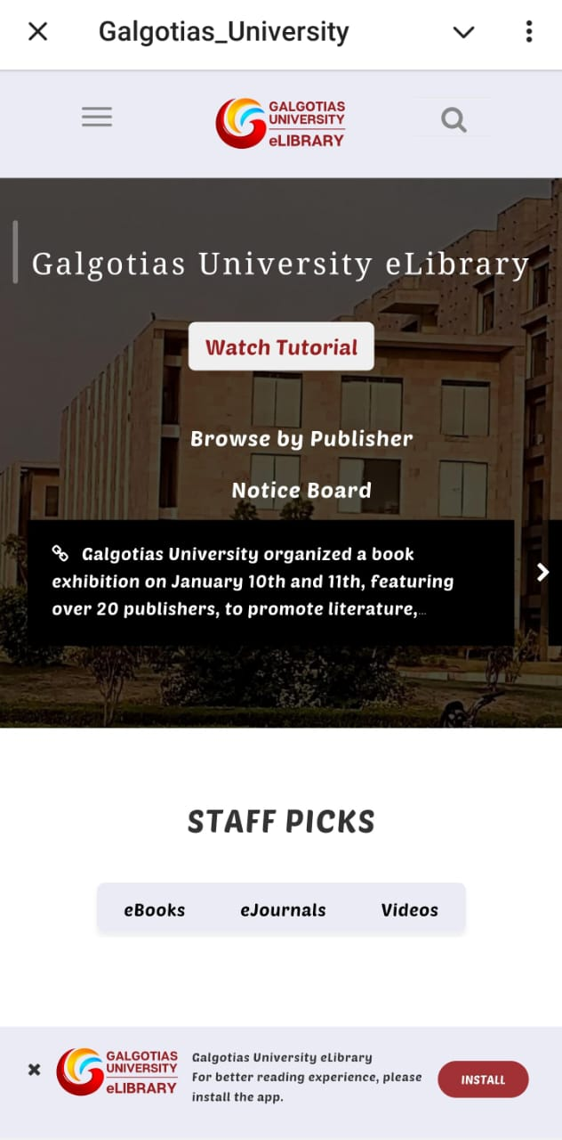
School of Computing Science and Engineering
Library Services Access
Book Search and Availability: Users can search the library catalog for books and other resources, check availability, and place holds or reservations.
Renewals and Due Dates: Easily renew borrowed books and receive notifications for upcoming due dates to avoid late fees.
Library Events and Workshops: Stay updated on library events, workshops, and new resource additions through timely notifications.
Program Name: B.Tech

Slide 8
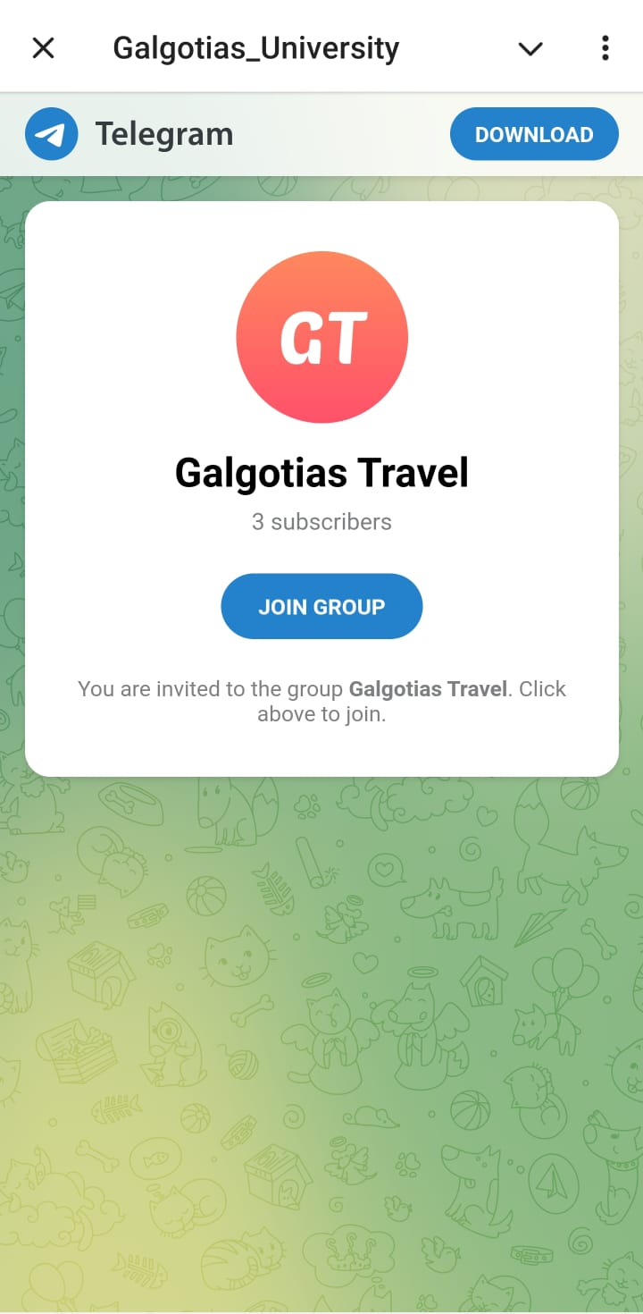
School of Computing Science and Engineering
Student Group Communication and Management
Group Chats and Channels: Facilitates communication within student groups, allowing for the creation of group chats and channels for specific courses, clubs, or interests.
Event Announcements: Share information about upcoming events, meetings, or deadlines with group members, ensuring everyone stays informed.
Polls and Surveys: Conduct polls and surveys within groups to gather feedback or make decisions collectively.
Program Name: B.Tech

Slide 9
School of Computing Science and Engineering
Conclusion
Recap of the Project Goals and Achievements The development of the Telegram bot aimed to provide a unified platform for students and faculty to access various university services easily. By integrating iCloud, EMS, LMS, library resources, and student groups, the bot has achieved the following:
Streamlined Access: Users can now access course materials, schedules, grades, and library resources through a single interface, reducing the time spent navigating multiple platforms.
Enhanced Communication: The bot facilitates better communication within student groups and between students and faculty, making it easier to share information and coordinate activities.
Automated Assistance: With automated responses to common queries, the bot has alleviated some of the workloads on administrative staff, providing quick answers and support to users.
User-Friendly Experience: The intuitive design ensures that users of all technical levels can easily interact with the bot, enhancing the overall experience.
Program Name: B.Tech

Slide 10
School of Computing Science and Engineering
Call to Action or Next Steps To further improve the Telegram bot and expand its functionalities, the following steps are proposed:
User Feedback Collection: Gather feedback from students and faculty to identify areas for improvement and potential new features.
Feature Expansion: Consider integrating additional services such as career counseling, internship opportunities, and event notifications.
Security Enhancements: Continuously improve data security measures to ensure the protection of user information.
User Training and Support: Provide training sessions and support resources to help users maximize the benefits of the bot.
Program Name: B.Tech

